Slide 1

Heatwave Meteorology

Slide 2
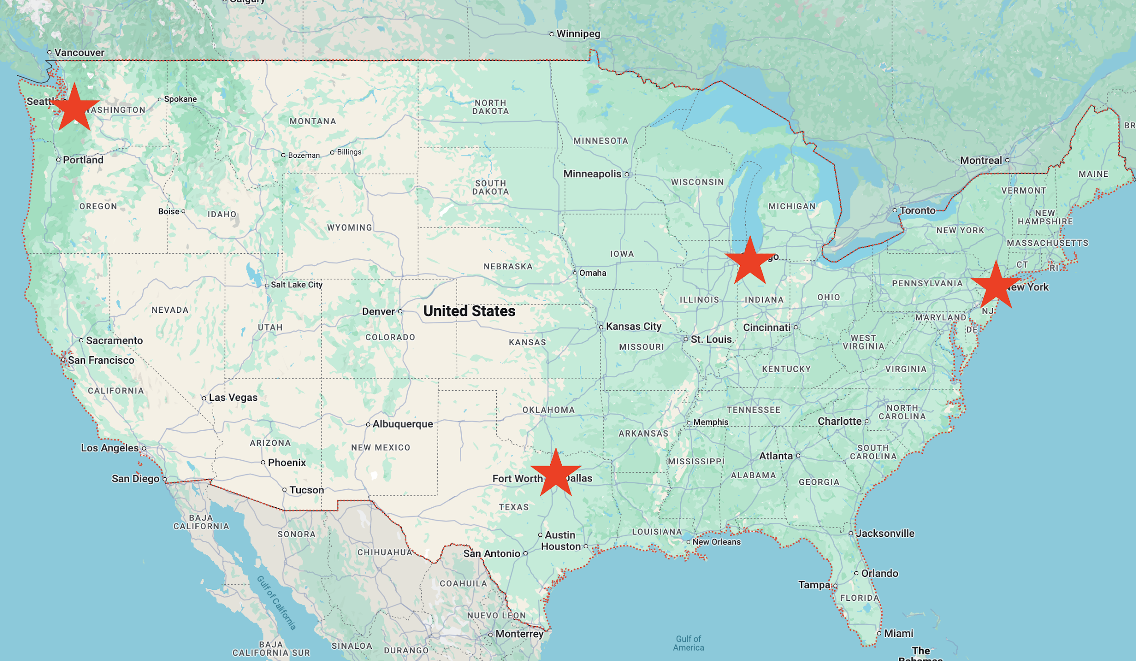
What are the synoptics of major heatwaves across the U.S.?

Slide 3
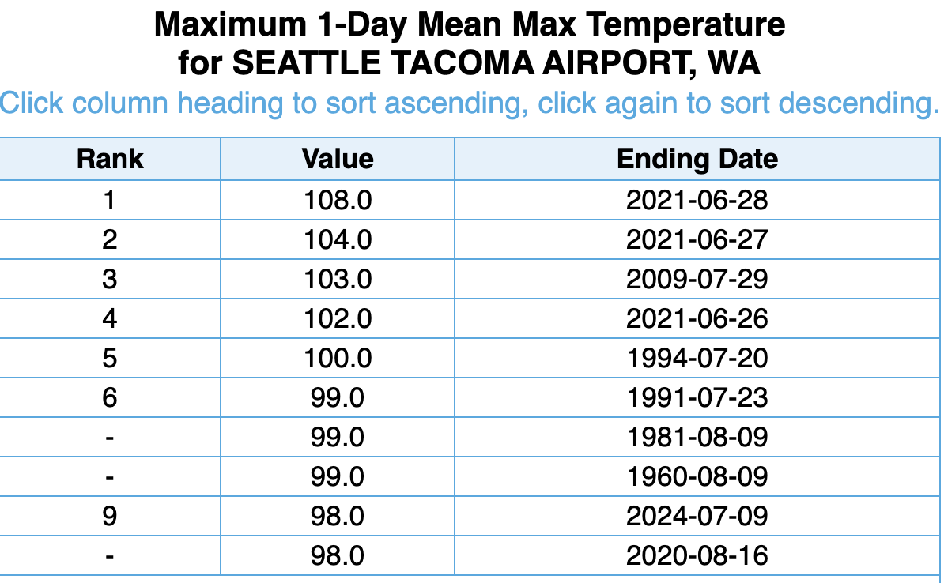
Seattle

Slide 4
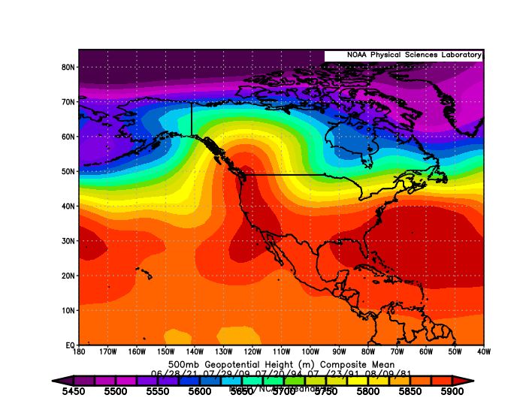
Seattle

Slide 5
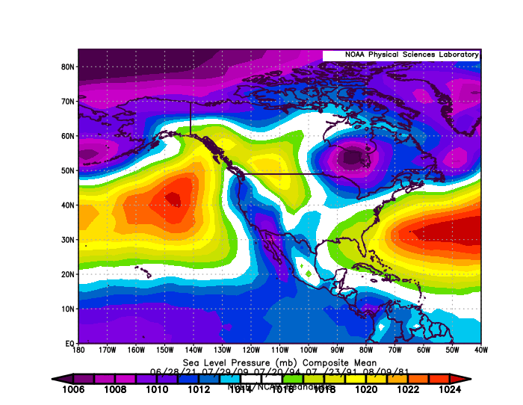
SLP

Slide 6
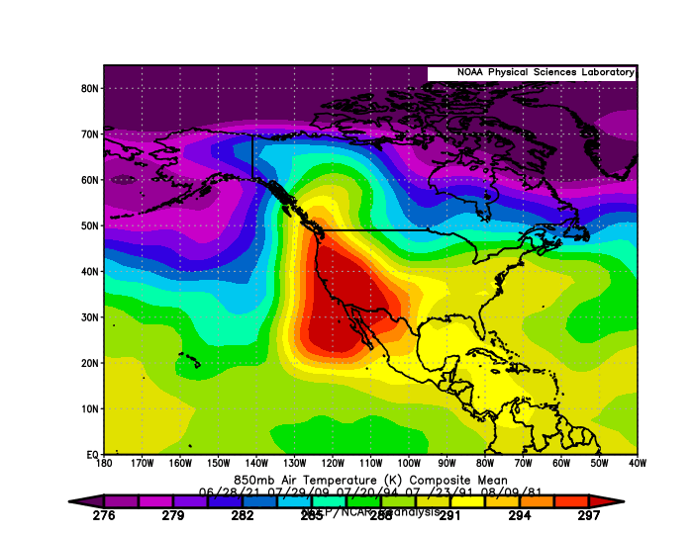
850 T

Slide 7
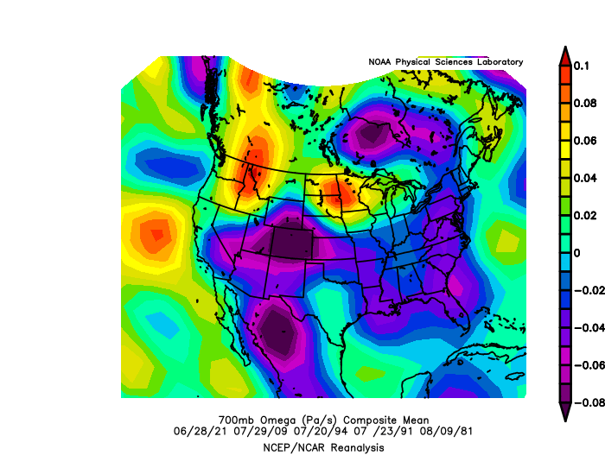
Omega 700 hPa

Slide 8
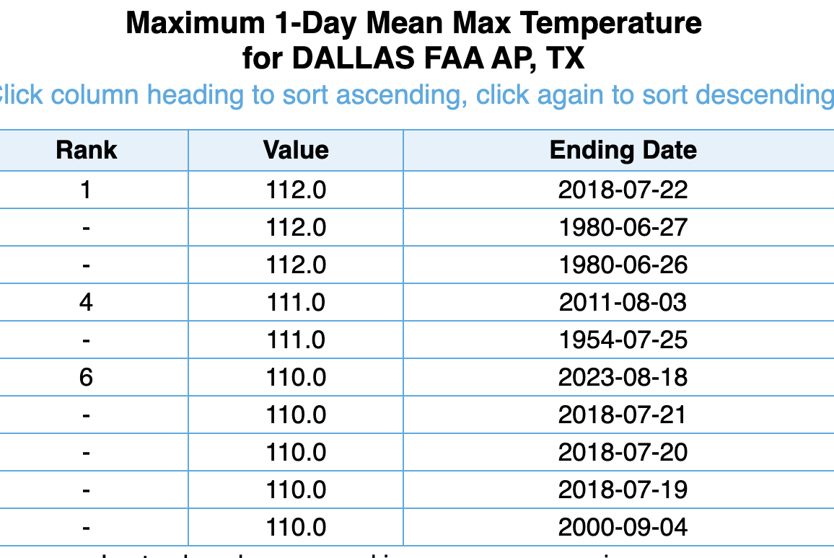

Slide 9
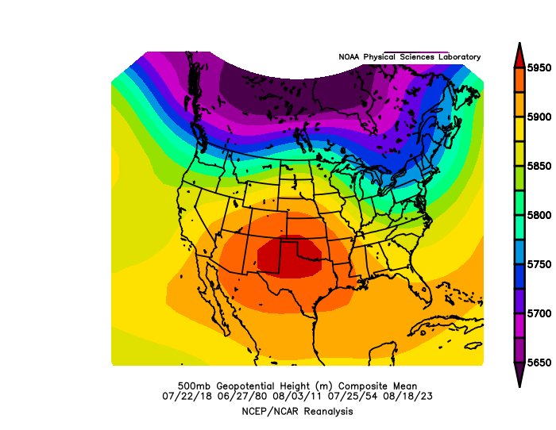
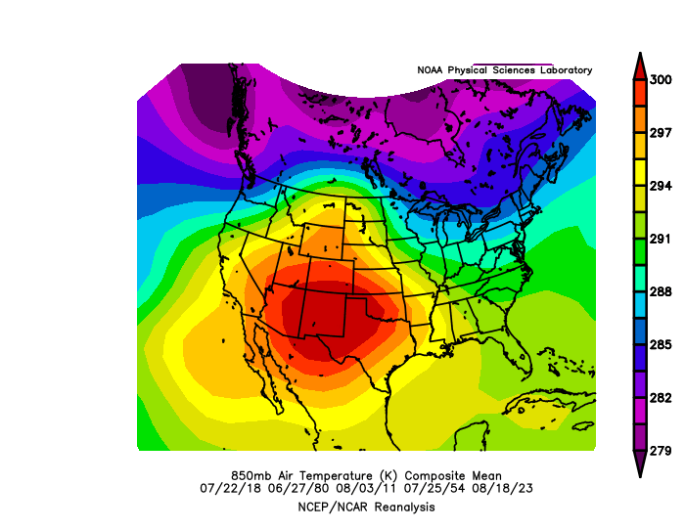

Slide 10
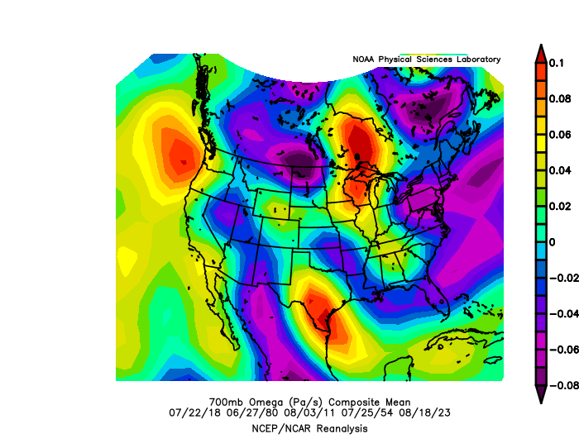
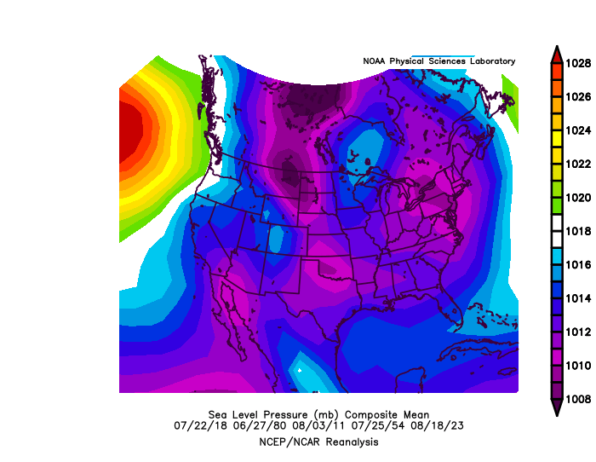
Sinking air in high

Slide 11
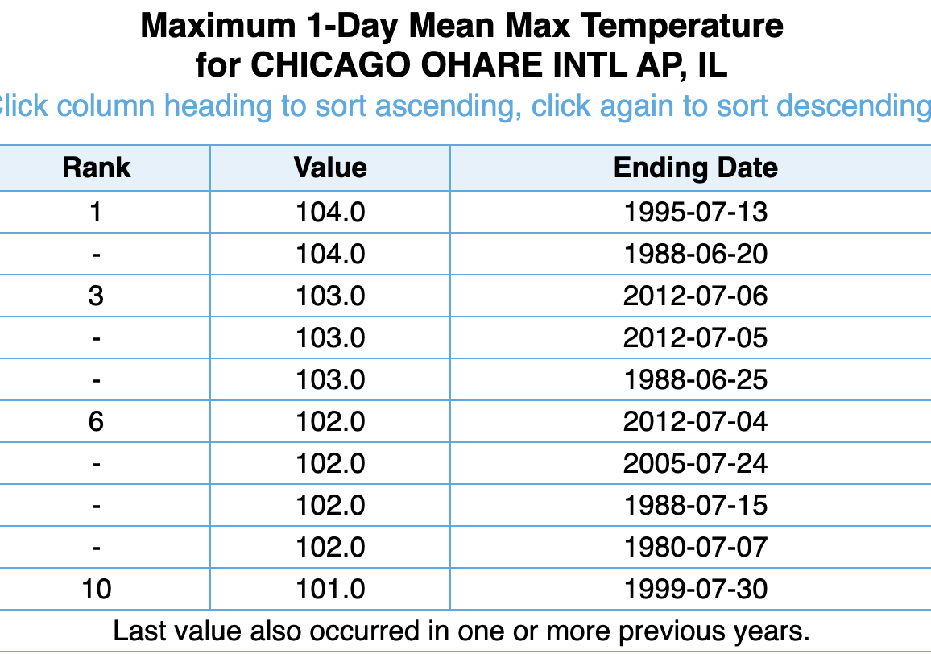

Slide 12
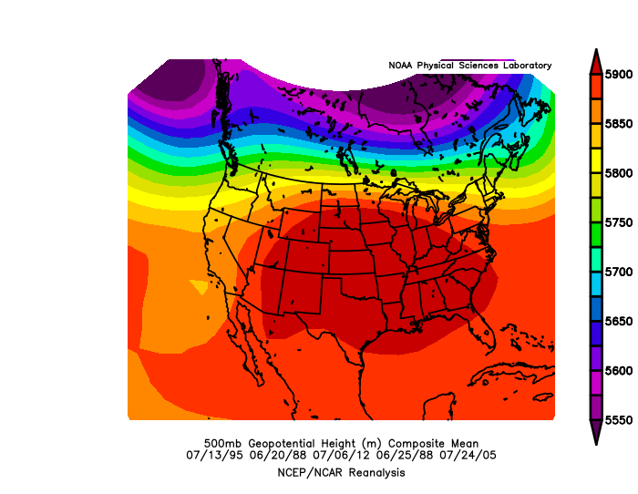
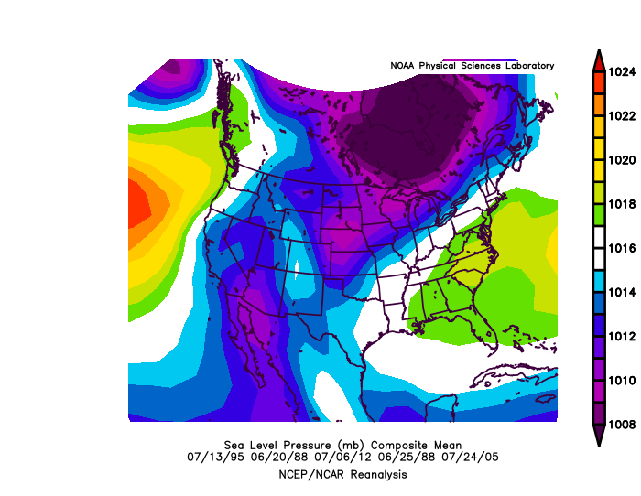

Slide 13
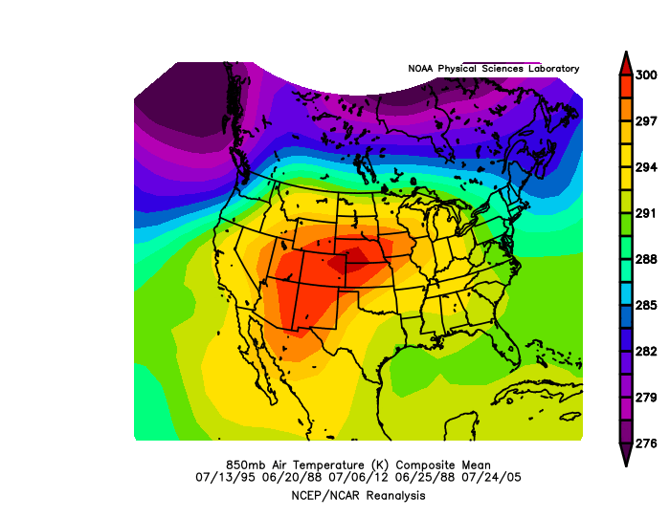
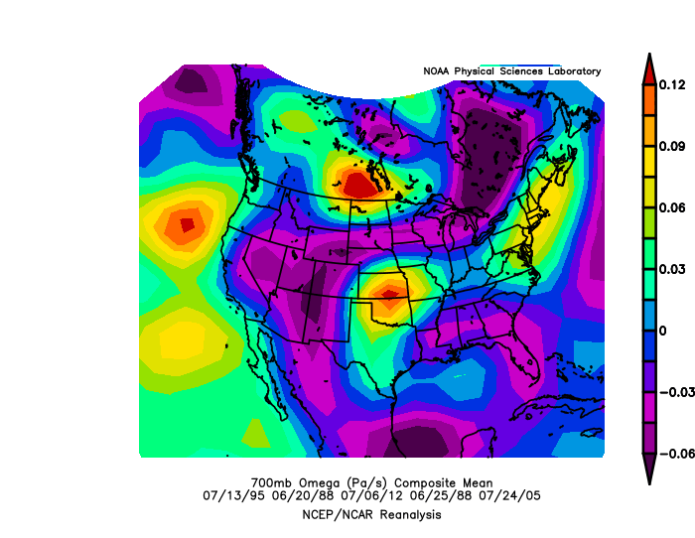

Slide 14
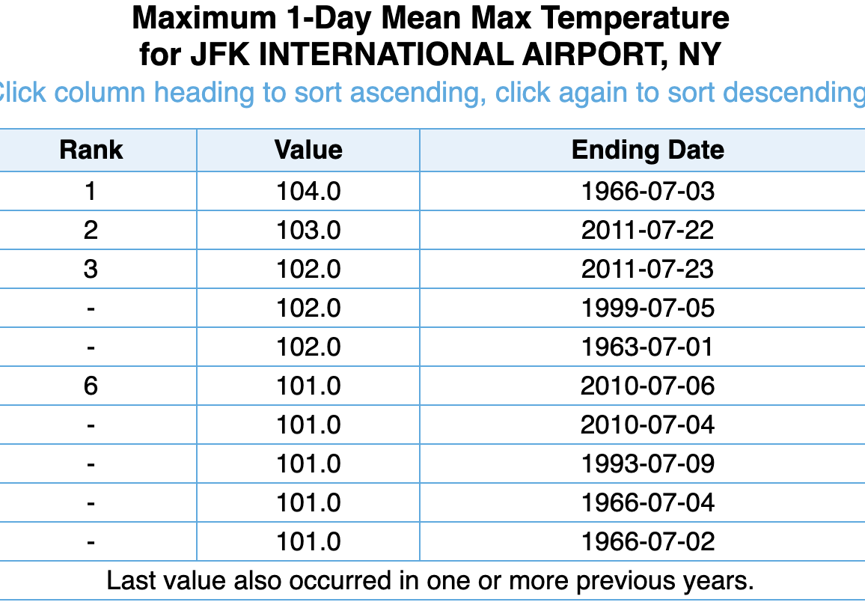

Slide 15
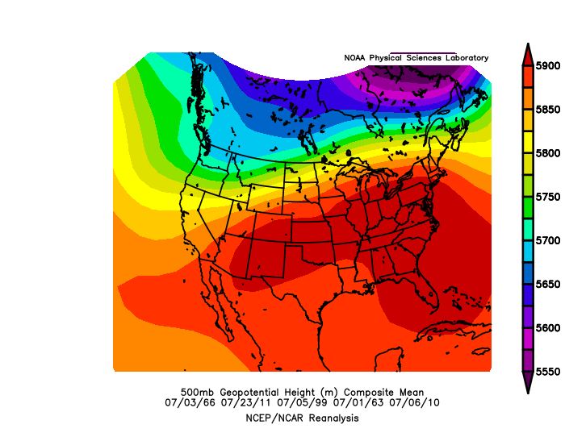
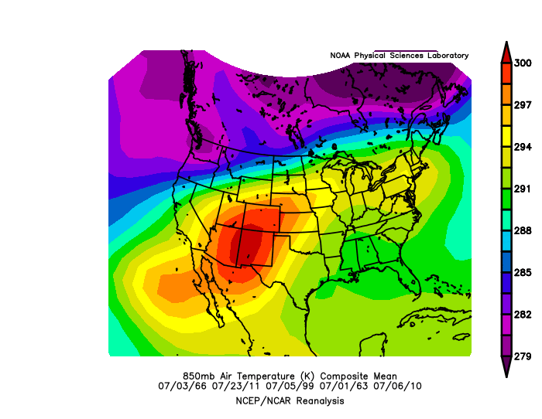

Slide 16
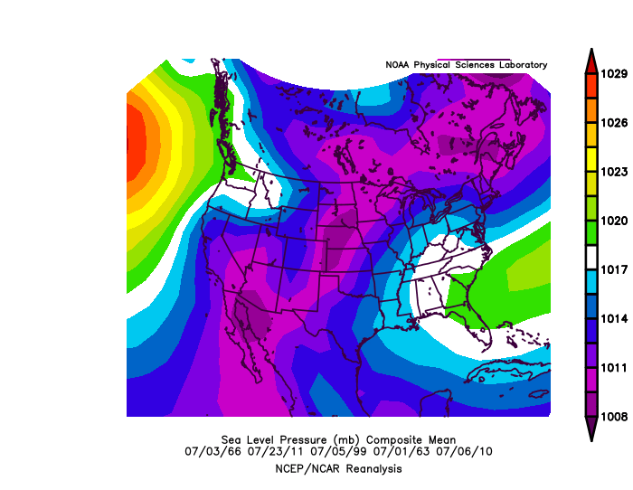
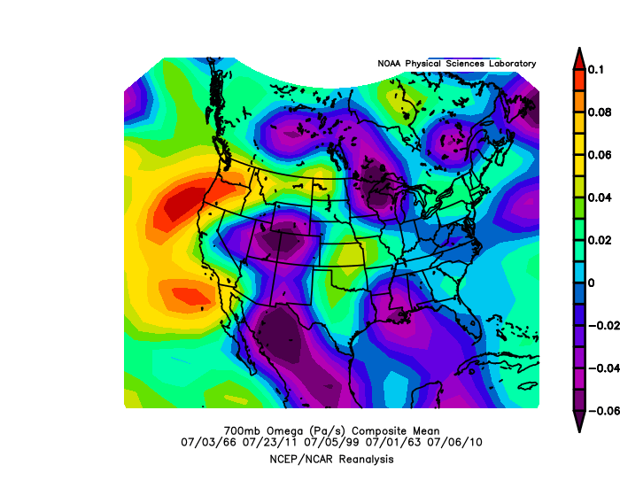

Slide 17
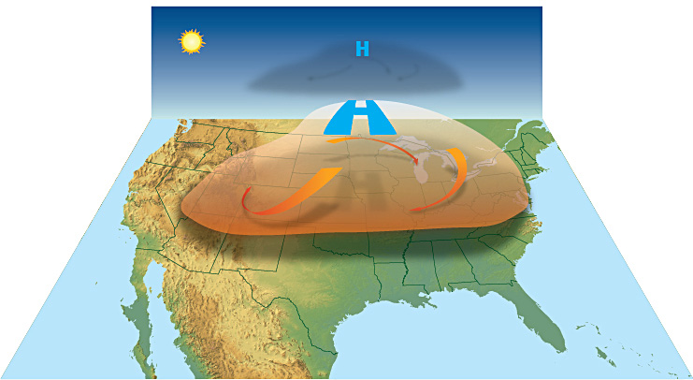
Take Home Message: All Have High Amplitude Ridge with Sinking Air Media Loves to Call This the HEAT DOME

Slide 18
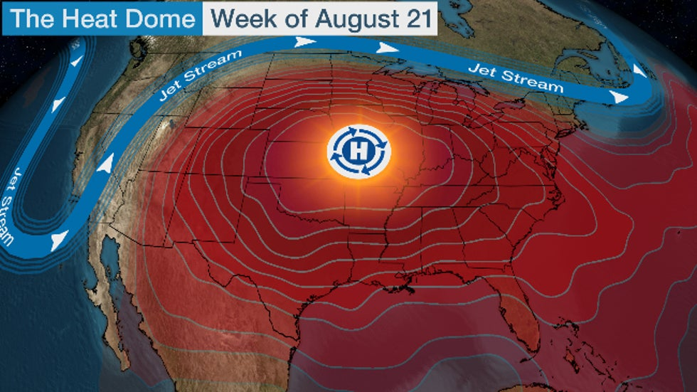
Warm is Associated with Sinking (adiabatic warming) and warm advection/latent heating on western side.

Slide 19
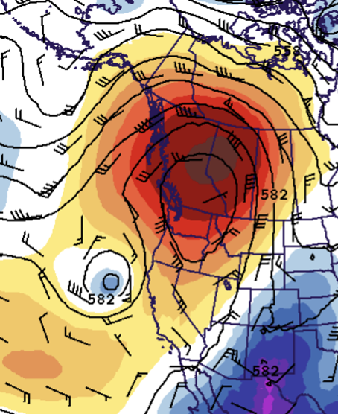
Summary: the three synoptic elements of heat waves
High amplitude ridge with descending air that warms by compression (a)
Warm advection on the western side that advects warm air and often moist air from the south. (b)
Condensation of moist air on the west side that supplies latent heating. ©
c
a
b

Slide 20
Heat Waves Can Also be Influenced by Terrain and Coastal Contrasts

Slide 21
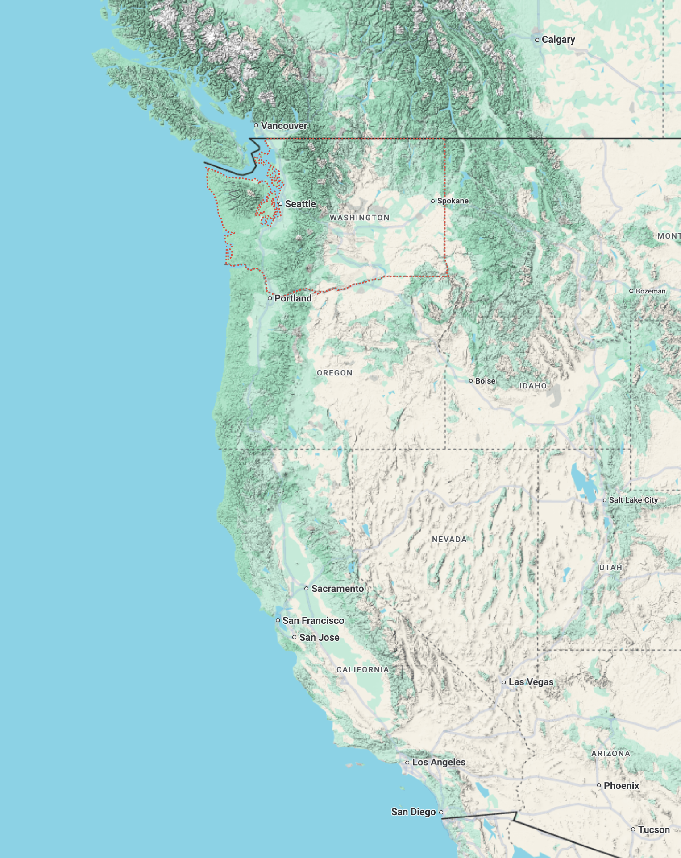
Can’t get heatwave with onshore flow
WARM
Cold
water
Need easterly wind for heat on the West Coast.
cool

Slide 22
Downslope flow helps heatwave
WARM
Adiabatic warming as air sinks on terrain

Slide 23
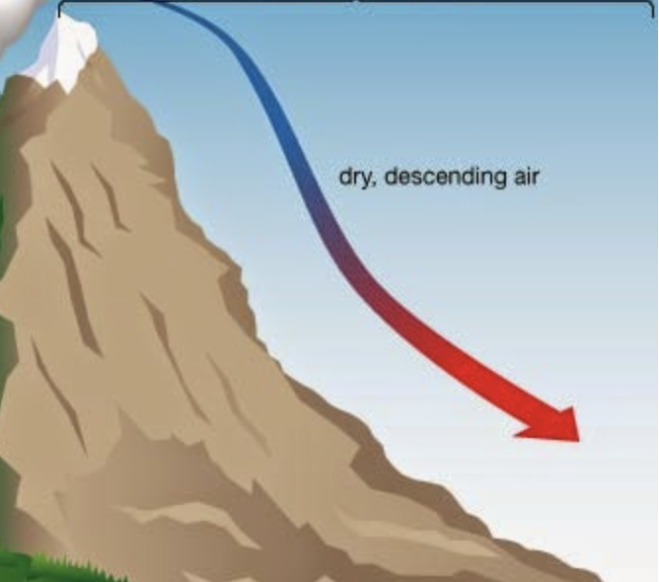

Slide 24
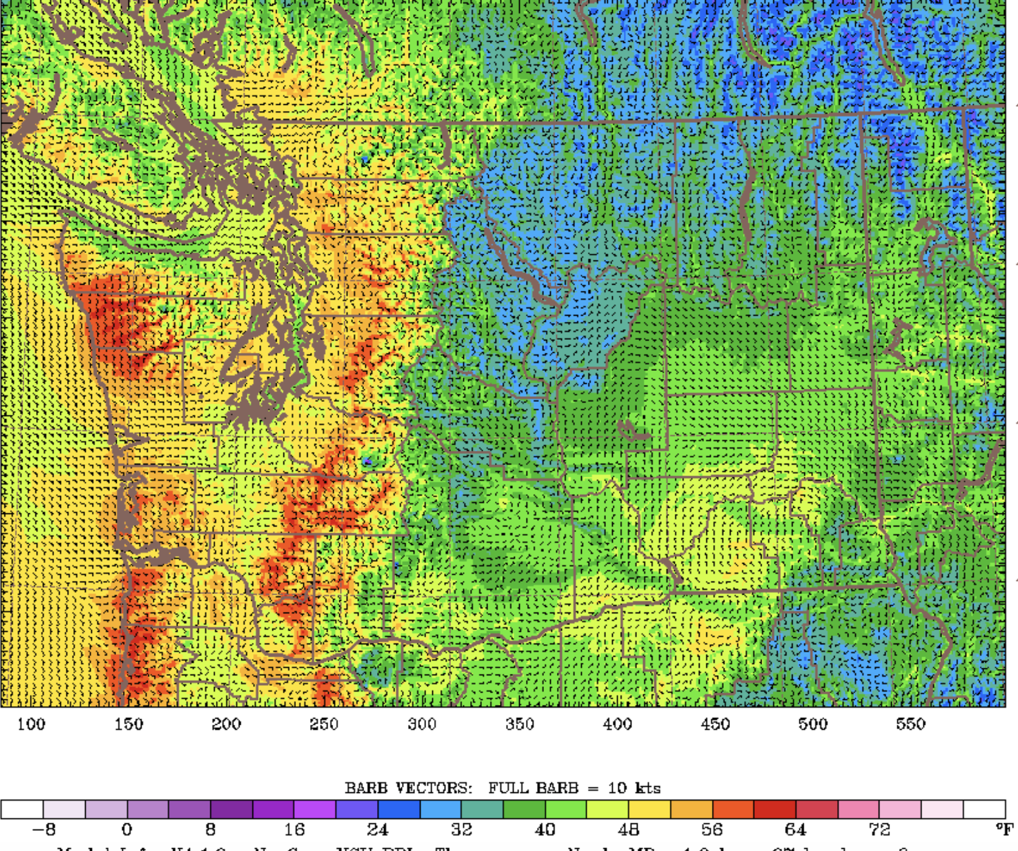

Slide 25
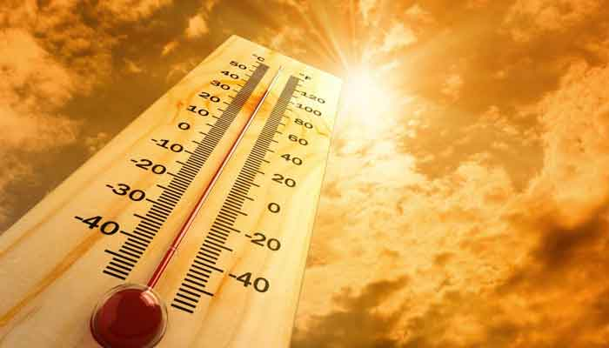
Consider the June 2021 Northwest Heatwave
All these factors occurred together

Slide 26
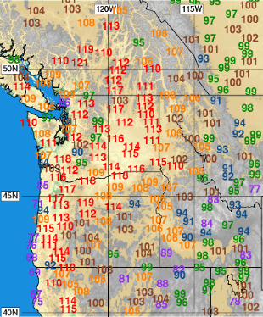
June 2021 Was the Most Extreme Heatwave In Northwest History
Station | Old Record | New Record
SeaTac | 103 | 108
Olympia | 105 | 109
Quillayute | 99 | 110
Portland | 107 | 116
New All-Time Washington State Record of 120F

Slide 27
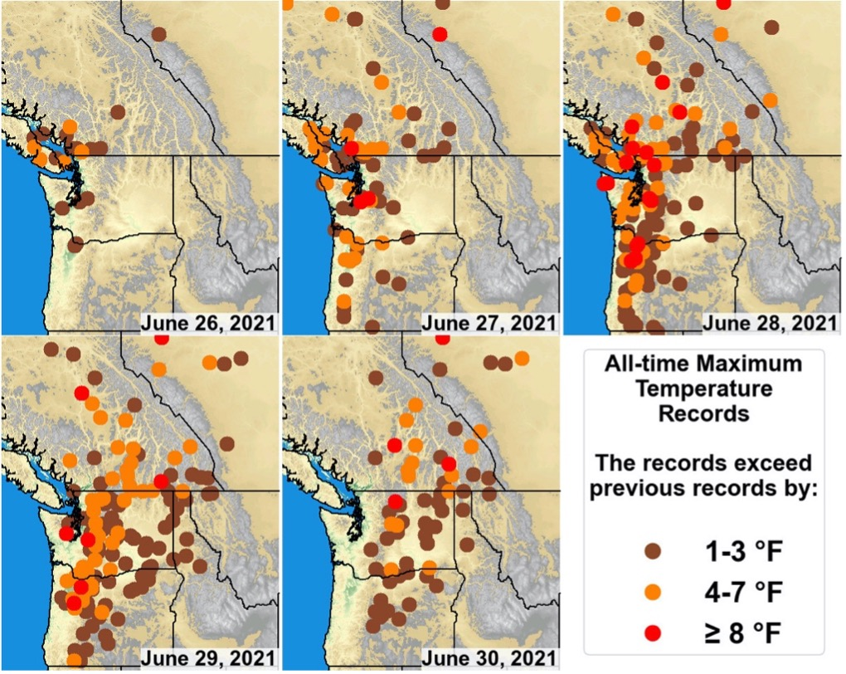
All-Time Records

Slide 28
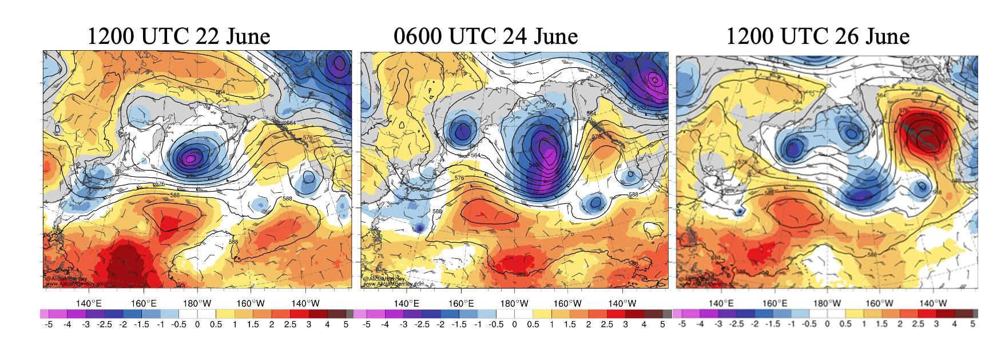
An Amplified Train of Waves Developed over the Northern Pacific, Driven by a Tropical Cyclone and Convection in the Western Pacific
500 hPa

Slide 29
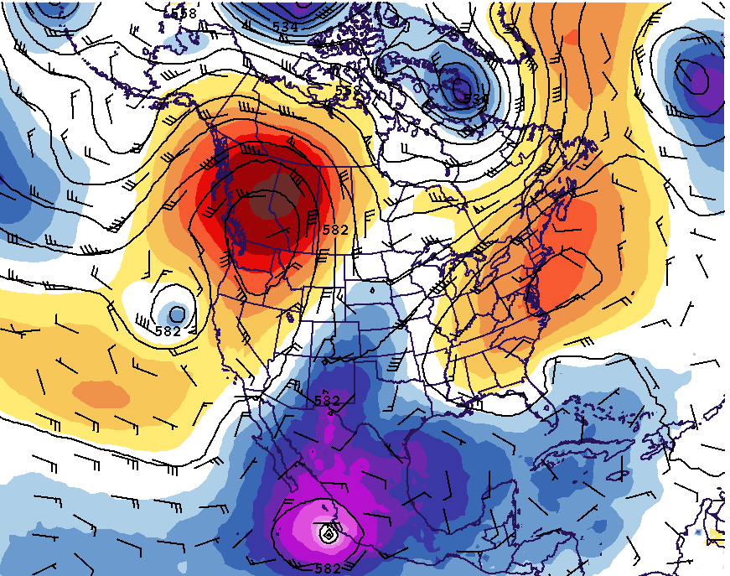
A Record-Breaking Ridge/High in the Ideal Position
Record 500 hPa heights
Record 500 hPa temperatures
Intense sinking and compressional warming
500 hPa Heights, 0000 UTC 28 June 2021

Slide 30
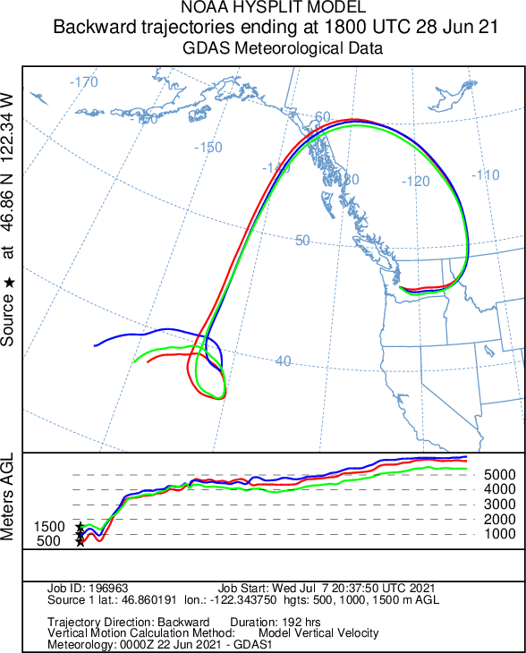
Record Warm Air Aloft Rapidly Subsided and then Descended over the Western Slopes of the Rockies, Cascades, and Coastal Mountains

Slide 31
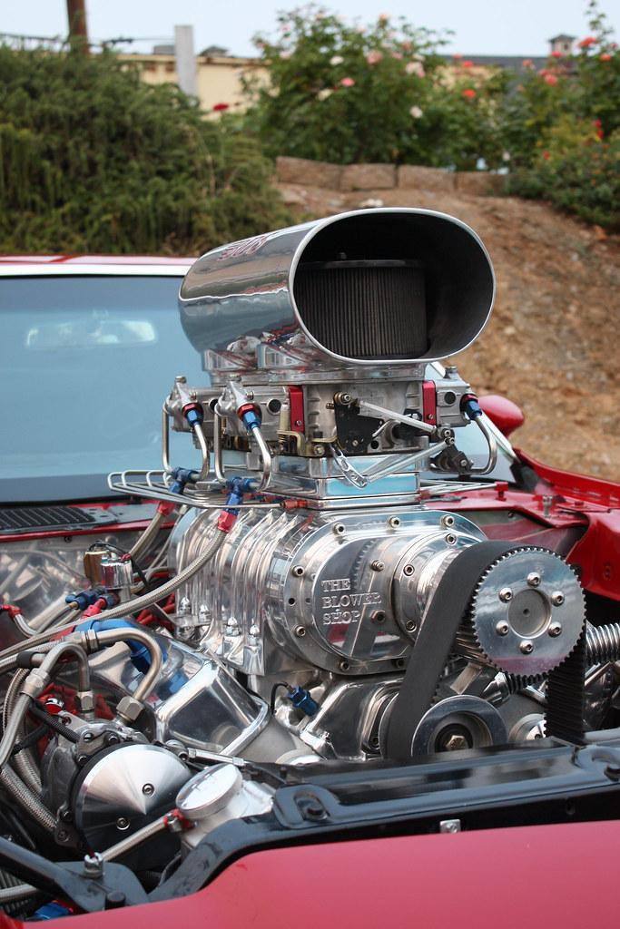
An approaching lower-tropospheric trough turbocharged the heatwave

Slide 32
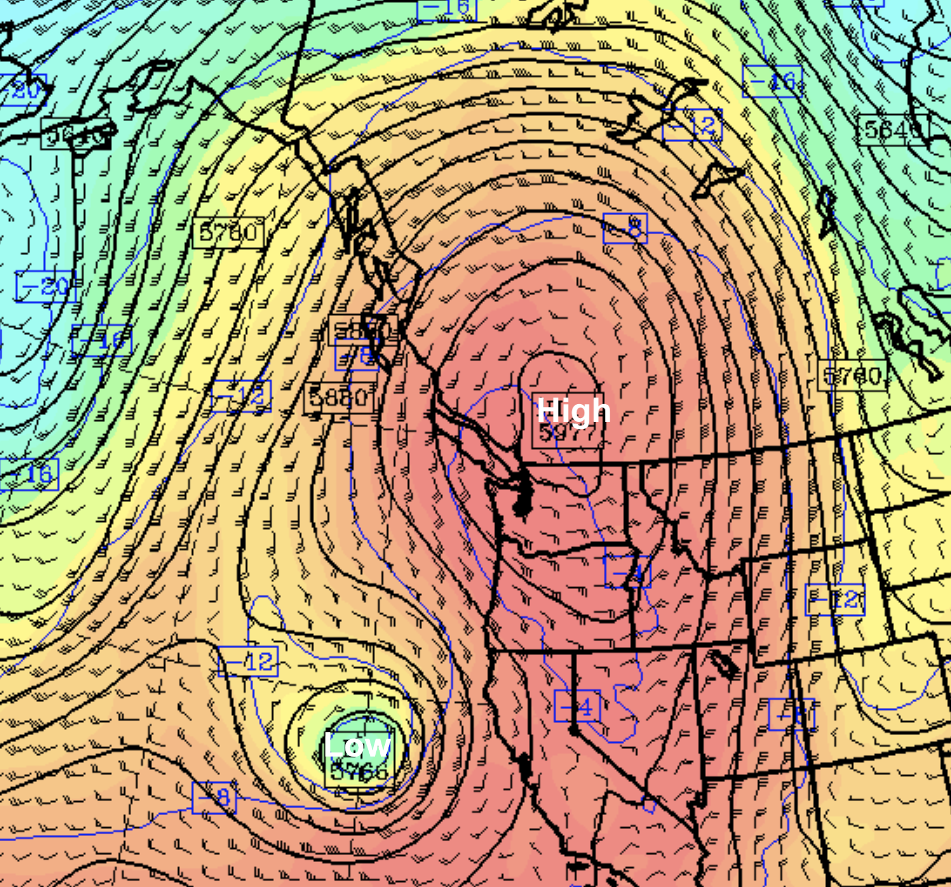
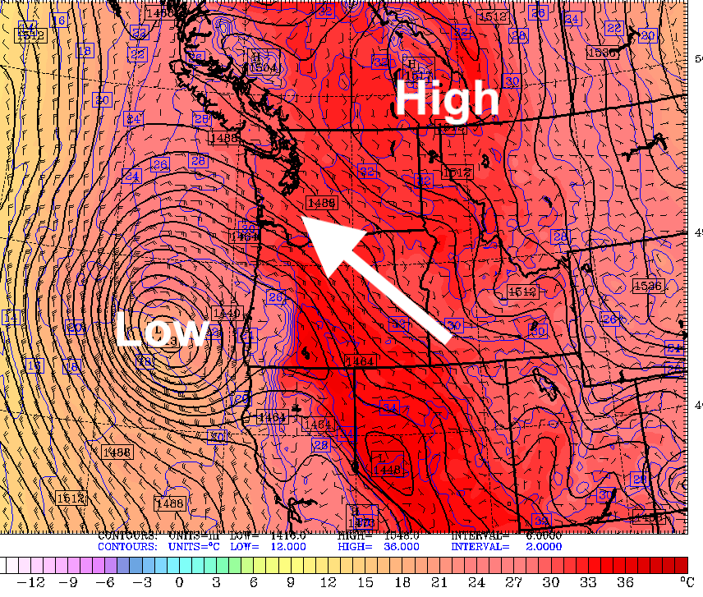
Approaching trough resulted in enhanced downslope (southeasterly) winds at low levels
500 hPa
850 hPa

Slide 33
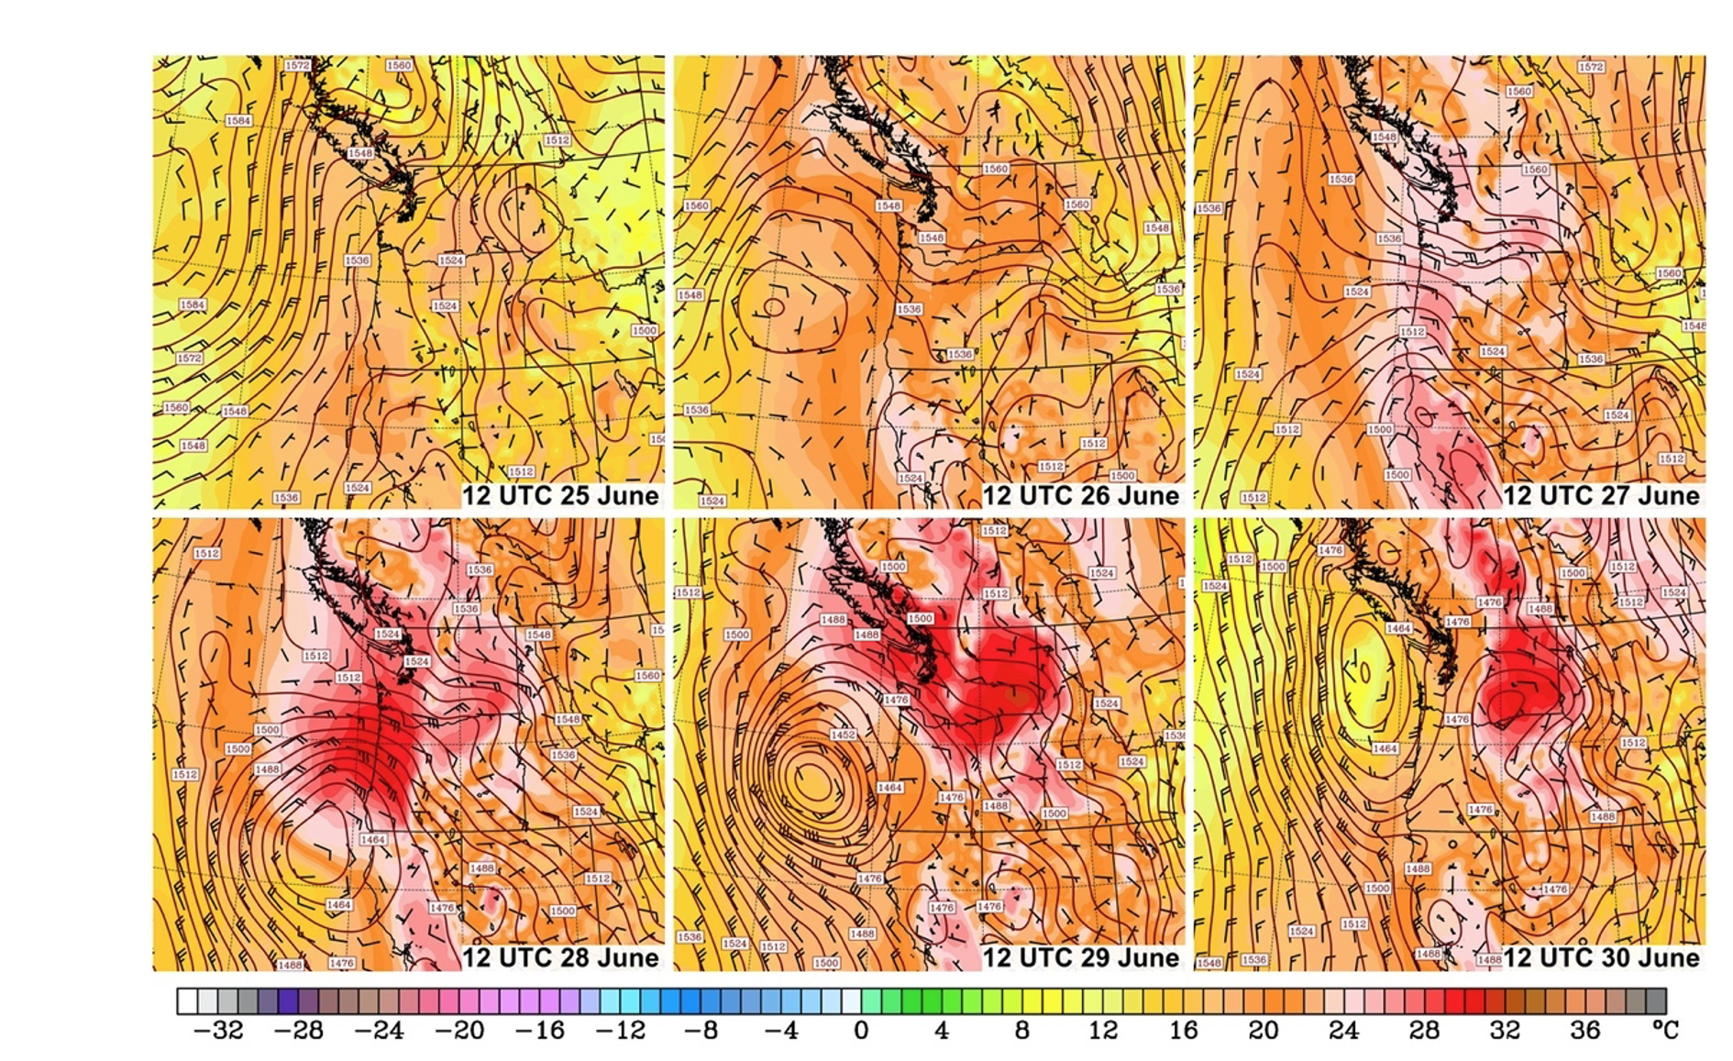
850 hPa ~1500 m

Slide 34
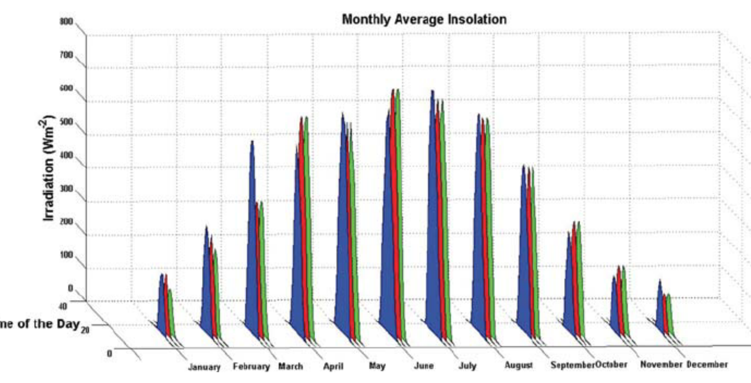
But there is more
The ingredients came together in late June, when the sun is near maximum strength.
Solar Radiation

Slide 35
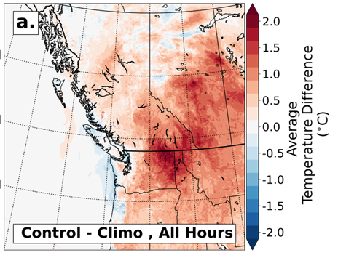
And dry soil conditions immediately before the heat wave increased temperatures by 1-3 F

Slide 36

The Bottom Line: Nature threw the meteorological dice…
An extraordinarily unusual combination of meteorological and other forcings

Slide 37
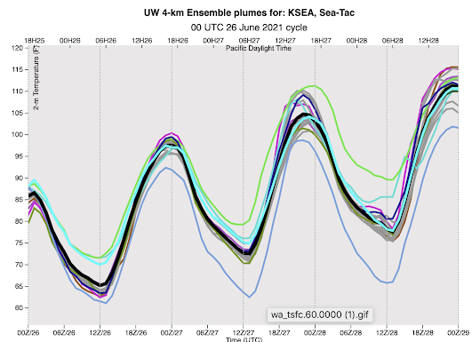
The Weather Prediction For the Event Was Extraordinarily Accurate
The record-breaking event was correctly forecast days ahead
Gave society time to prepare.
Improved weather prediction is a potent tool to protect society from extreme weather.

Slide 38
Cold Waves

Slide 39
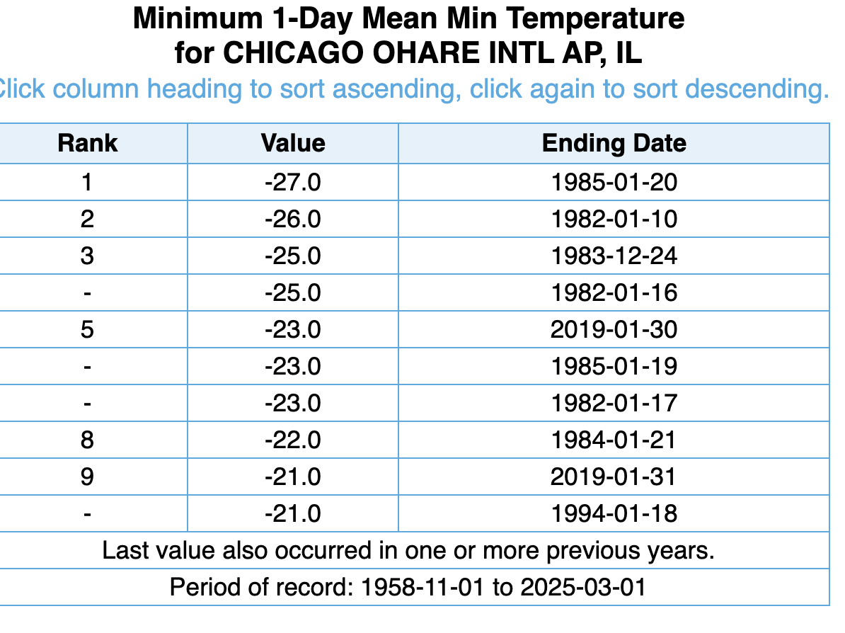
Consider Chicago

Slide 40
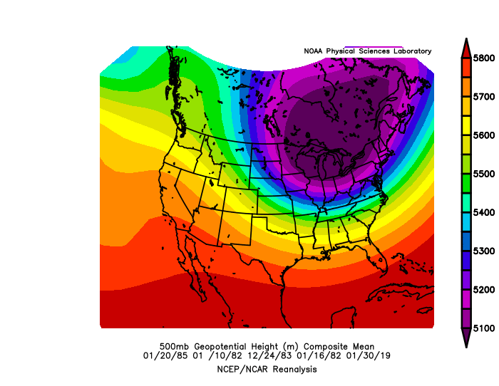
LOW

Slide 41
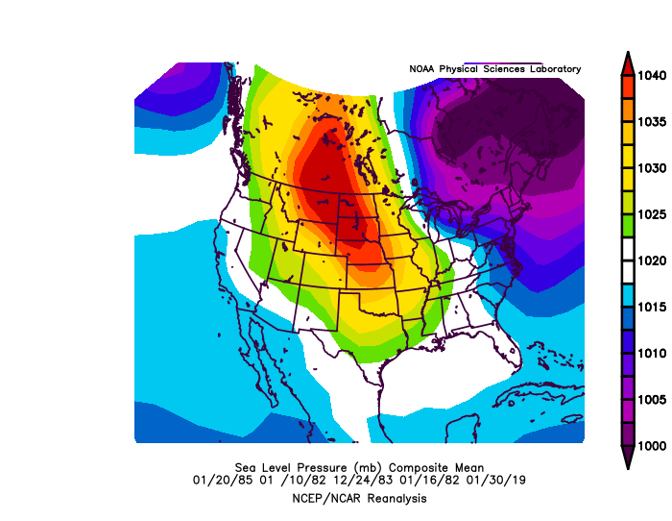

Slide 42
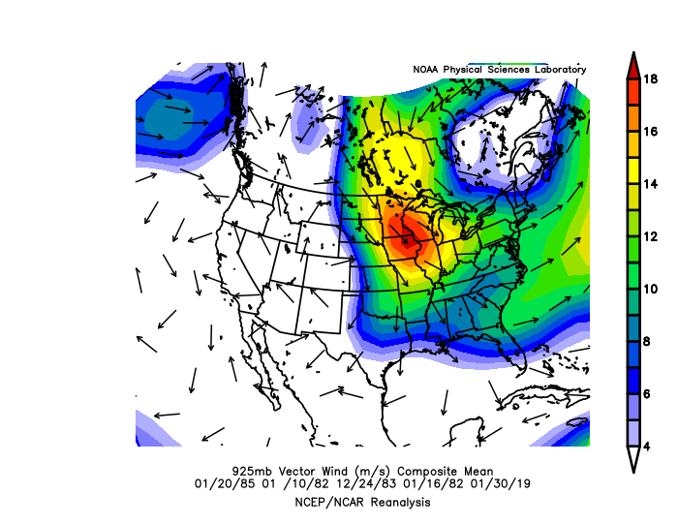
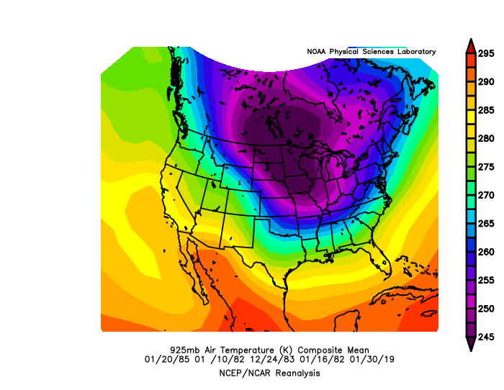

Slide 43
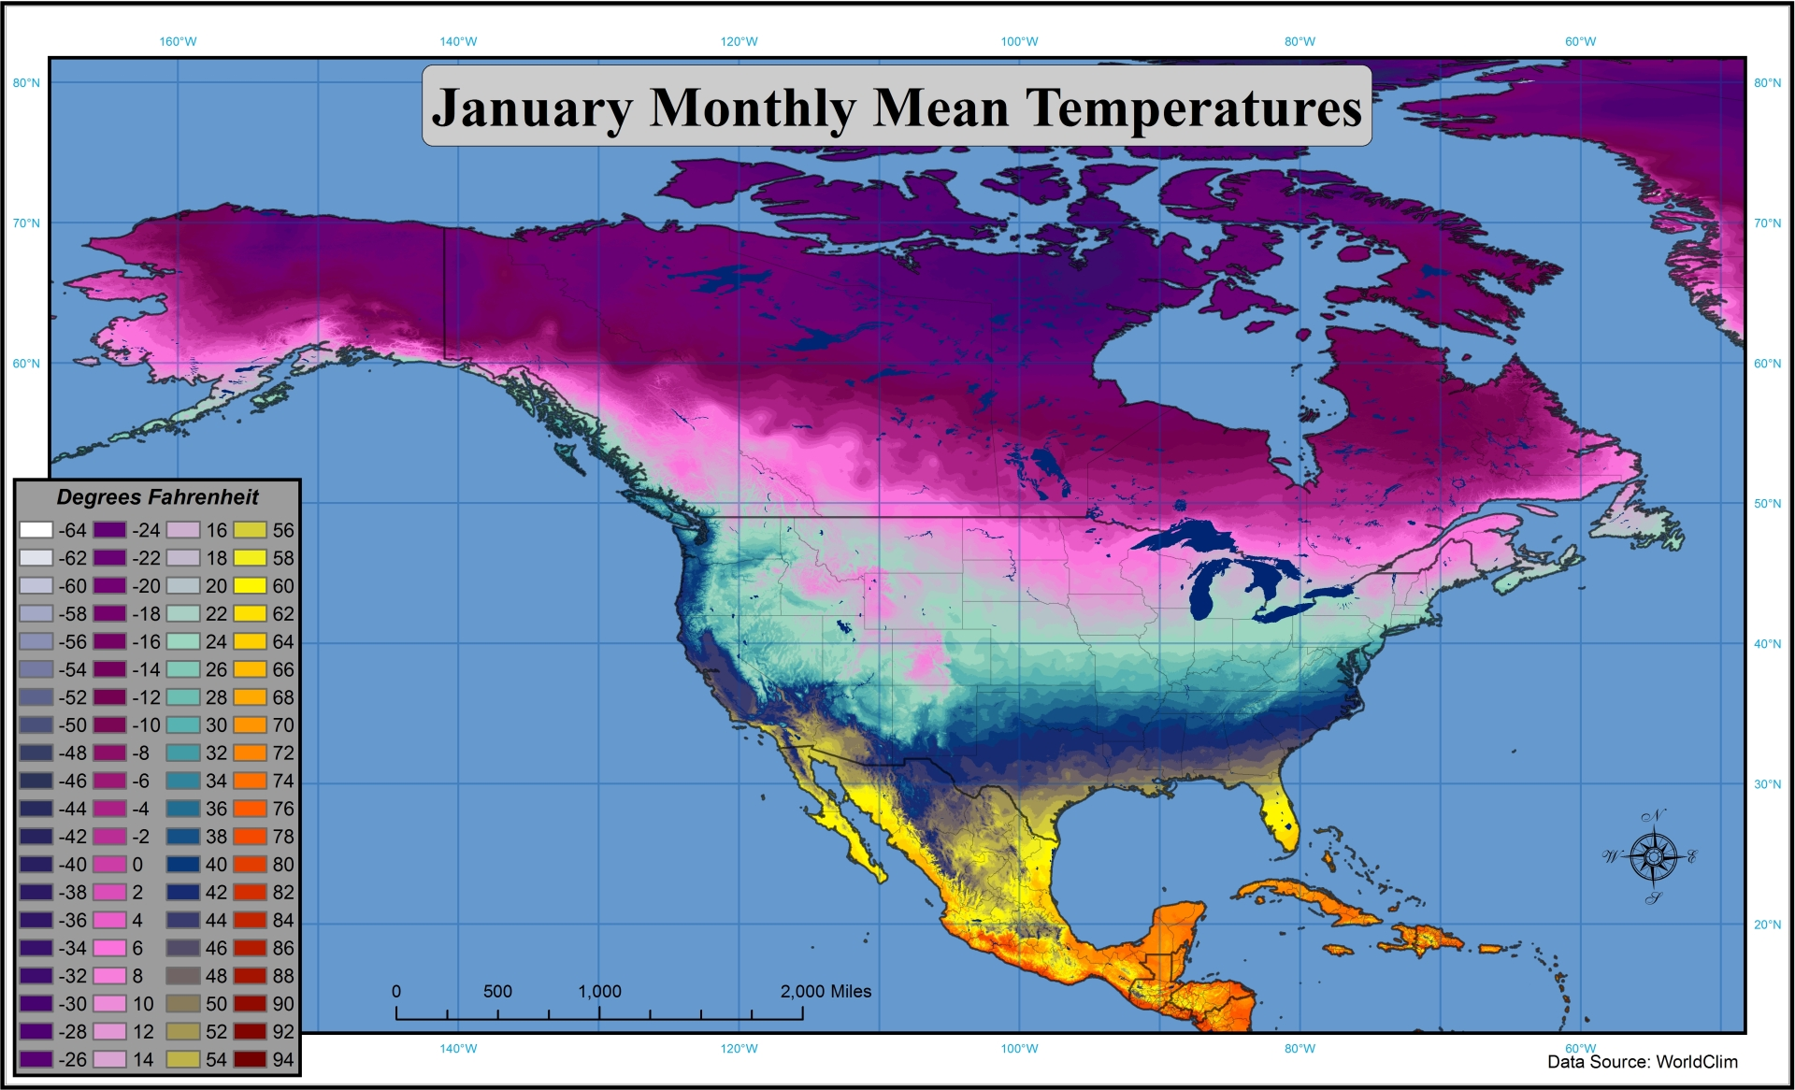
Cold waves over the eastern/central US
Low to the east and high to the west drives low level cold air from northern Canada southward into the Great Plains and eastern U.S.
Unlike heatwaves, very motion is not very important.

Slide 44
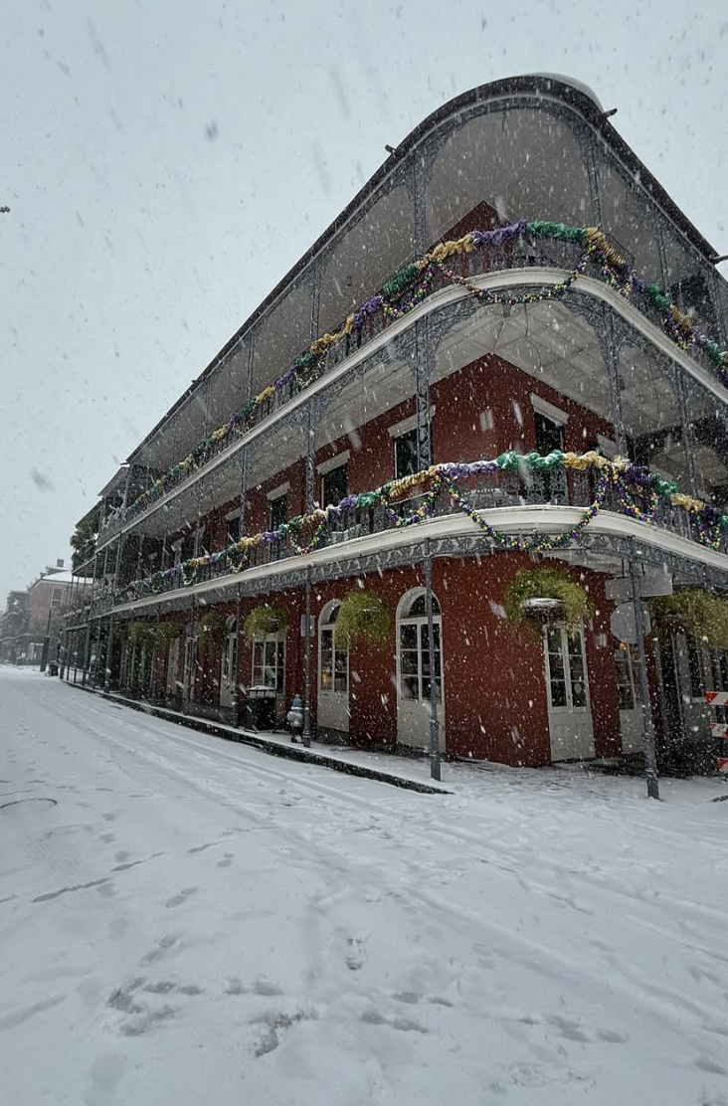
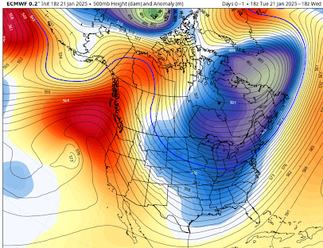
Three weeks ago. Major Cold Wave

Slide 45
Hard to get major cold waves on the West Coast.
Why?

Slide 46
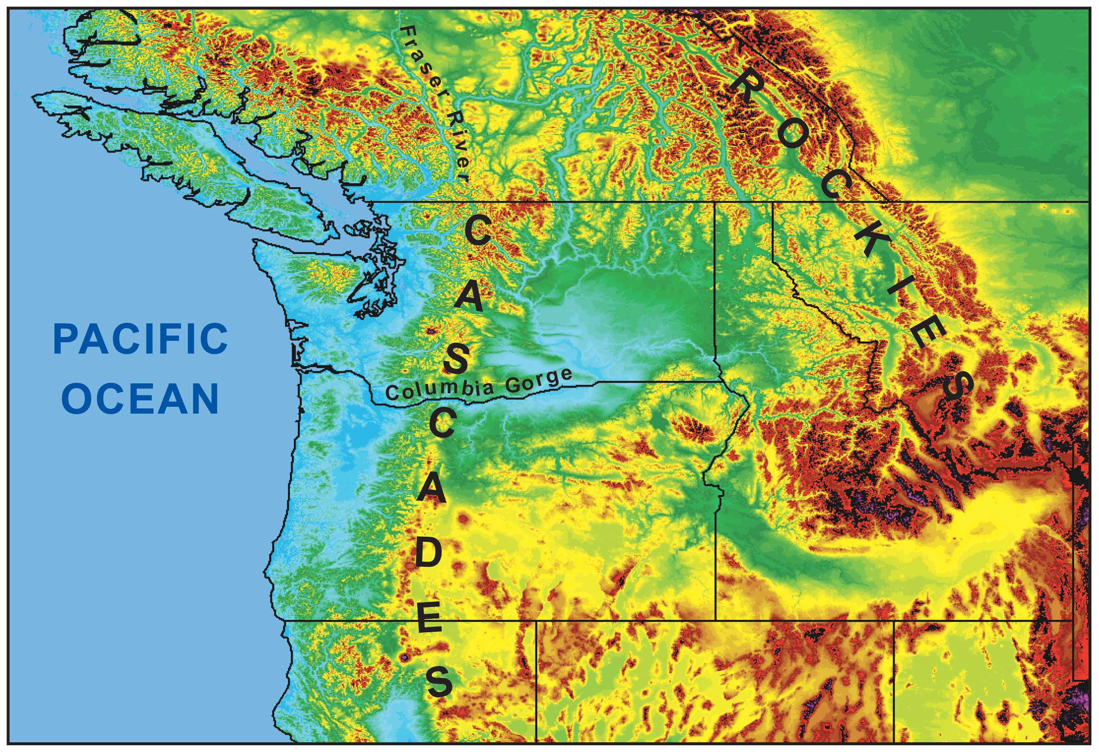
During the winter, the mountains block the cold air from the interior.
Cold
Air

Slide 47
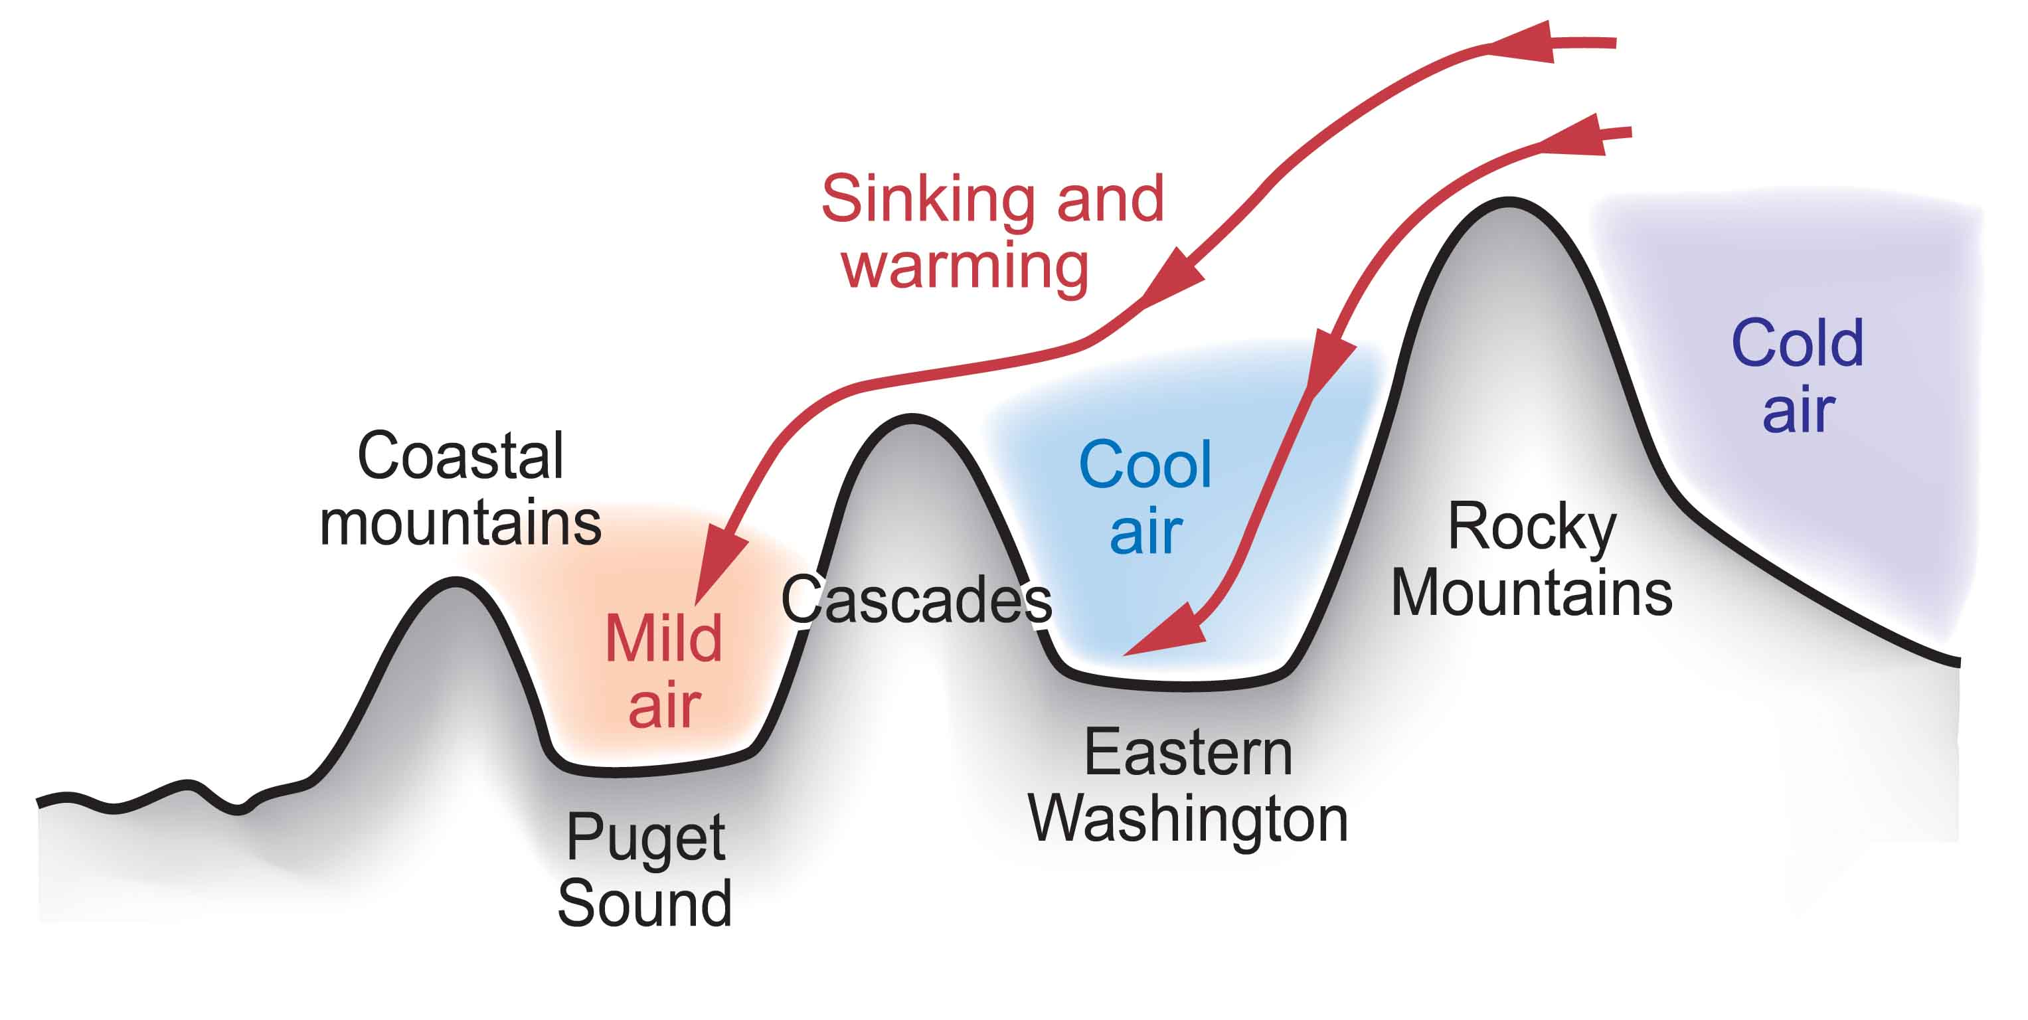
Cold Air from the Continental Interior Has a Hard Time Reaching Western Washington
Adiabatic compressional warming as air sinks on western slopes

Slide 48

Our air and weather systems generally
move west
to east:
Thus, our
weather comes from off
the mild
Pacific--so we tend to be wet and mild.

Slide 49

Mild Winter

Slide 50

The end

